Slide 1
OVERVIEW OF THE FINAL PROCESS
BUSINESS PROBLEM
Classification of tickets and assignment to their appropriate resolver groups based on available ticket data and features
OUR APPROACH
Division of data into two groups, one for groups with low number of records and the other for groups with high number of records
SELECTED STRATEGY ELEMENTS
Features of Data:
Ticket descriptions are Multilanguage
Data is highly imbalanced
Data has text as well as numeric features
Our preprocessing steps:
Extract numeric features
Cleaning data, encodings using FTFY
Translating records, Augmenting the data
Translation used:
G-translate loops with backout
Translation runs before and after data cleaning
Augmentation used:
Random augmentation of upto 10 words in a record
Random word dropping at ~15%
Algorithms used:
Logistic Regression, SVM, XGB
Random Forest, LightGBM, CatBoost
GRU, LSTM, Bidirectional LST
Techniques used:
Skip connections in GRU
Joining LSTM text and Numeric models
Running data through multiple models to maximize precision and recall

Slide 2
SOLUTION ROADMAP: STEP BY STEP
ACTION
FINDING
DETERMINATION
Step 1
Perform EDA on data to discover data challenges
Imbalanced target group distribution, garbage words & multilanguage source data
Need for Data, cleaning translation & augmentation
Step 2
Perform Data cleaning on the dataset to remove fluff words and garbage
Data encoded in UTF-8
Requires conversion into corresponding language codes through FTFY
Step 3
Initiate Language Translation through google translate libraries
Partial translations on first attempt
Greater translation requires removal of additional markers such as <Chinese text>,34323 → detected as English

Slide 3
SOLUTION ROADMAP: STEP BY STEP
ACTION
FINDING
DETERMINATION
Step 4
Augment data to create a larger dataset
Standard augmentation with synonyms fails to capture latent relationships
Inclusion of drop words augmentation
Step 5
Demarcate datasets into rule-based and AI-based and perform vectorization
Increasing features increases accuracy for TFIDF, additionally, some feature engineering also helps
Improved feature extraction required, and further combination of models needed
Step 6
Perform machine learning and deep learning on data
Accuracy lacking in some target groups
Improve feature extraction, translation and data cleaning

Slide 4


MODEL EVALUATION
FINAL MODEL
Random Forest
High overall accuracy on test set
High individual accuracy on target classes
Strong balance between precision and recall
BEST PARAMETERS
'criterion': 'entropy’
'max_depth': None
'max_features': 'log2’
'n_estimators': 50
Objective
Performance on test data
Performance on validation data
Performance on re-augmented test set
Individual class-wise accuracy/precision/recall above threshold
PROMINENT PARAMETERS
Increasing n_estimators directly reduces overfitting of the model and increases test accuracy
Evaluation of Success

Slide 5
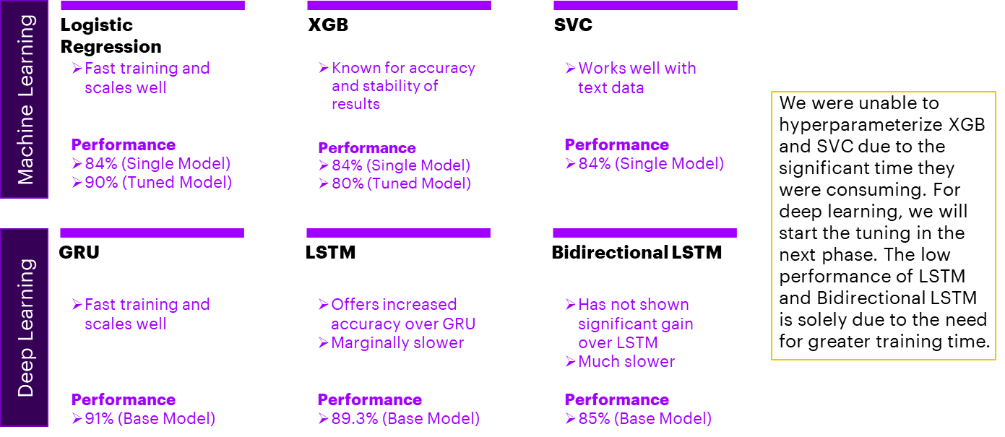
INTERIM PERFORMANCE OF MODELS

Slide 6
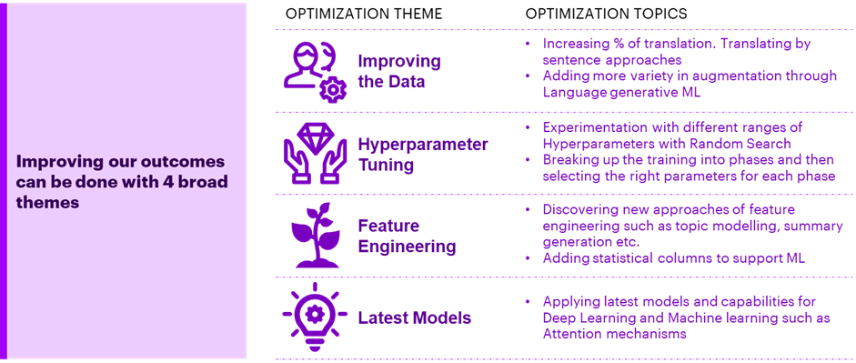
OUR INTERIM PLAN ON FUTURE OPTIMIZATIONS

Slide 7
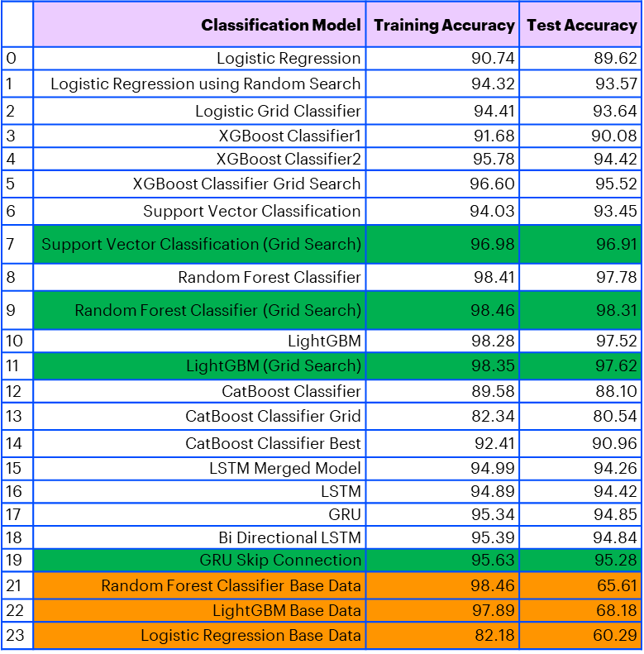
OUR FINAL MODELS
Models selected
Models on base data

Slide 8




COMPARISON TO BENCHMARK
WE DELIVERED OVER 7% IMPROVEMENT TO OUR 91% BENCHMARK IN THE INTERIM
1
2
3
4
IMPROVEMENT IN MODELS
IMPROVED FEATURIZATION
IMPROVED DATA TREATMENT
IMPROVEMENT IN TUNING
Leveraging Skip Connections, Merged deep learning models, we were able to improve deep learning accuracy past 95%
We improved our augmentation outcomes and variety, increased the degree of translation to almost 100% and reduced the data loss from cleaning
We brought our hyperparameters closer to optimal ranges using coarse and fine gradations from the default values
Compared to our interim efforts, we extracted multiple new features of value to the classification
Our final accuracy was above 98% using random forest models, this is a 30% improvement over the translated data without augmentation

Slide 9




IMPLICATIONS FOR BUSINESS
Faster assignment to groups
Accuracy of assignment
WE recommend
Level of confidence
The solution proceeds through the test group
(19744 records) in around 10 minutes for 3 models. This means that assignment is being performed at 2000 records per minute. Compared to human assignment, this is several hundred times faster
The best model of the lot is random forests, which provides 98.31% accuracy. Combining this with other deep learning models, we can move towards nearly 99% accuracy which would be a significant improvement over human assignment
We recommend the below
Dissolution of groups which have less than 1% records from the total
Auto resolution of several tickets that relate to SID’s or Hosts or batches that have failed. They can be automatically restarted based on detection
Based on the set of values we obtain from our best models; we can estimate the accuracy to be within 96.3% - 98.61%, 99% of the times.

Slide 10



LIMITATIONS OF THE MODEL
LIMITATIONS, REAL WORLD DEFICIENCIES, AND FUTURE ENHANCEMENTS
Limitation:
CHINESE LANGUAGE
Currently, the caller is a key differentiating factor in the tickets raised in Chinese language. However, as tickets increase, there could be some overlap between the users in different groups causing accuracy reduction.
Additionally, tickets raised automatically in groups 5,6,8,9 are challenging for the algorithm to classify
deficiency:
Limited data
Real world data can be vastly different from the data provided. In production scale ticketing systems, organizations can get hundreds of thousands of tickets per year. This means that we would not have captured the entire vocabulary for real time assignment, nor planned for its full impact on performance & future training
Enhancement:
CONTINUED LEARNING FROM CLOSED TICKETS
We need to configure the solution in a way that allows models to continuously be trained on new data as it arrives
The solution also needs to generate new patterns of language and vocabulary to create a deeper coverage of what a caller may raise in a ticket

Slide 11







CLOSING REFLECTIONS
OBSERVATION
LEARNING FOR FUTURE
LOW ACCURACY IN 6% of target groups discovered post model building
GROUP BY GROUP RECORD REVIEW IN AS PART OF INITIAL EDA
DATA
Accuracy reduction due to data loss in cleaning data
DETERMINATION OF VALUE OF EVERY FEATURE/COLUMN PRIOR TO CLEANING
LARGE DEVIATION FROM BASE HYPERPARAMETERS DURING TUNING CAUSING LOSS OF EFFORT
GRADUAL GRADATION OF HYPERPARAMETERS FROM DEFAULT SETTINGS
MODEL
A SINGLE MODEL DOES NOT SUFFICE FOR ALL INFORMATION
STACKING OR MERGING MODELS MAY IMPROVE ACCURACY

Slide 12
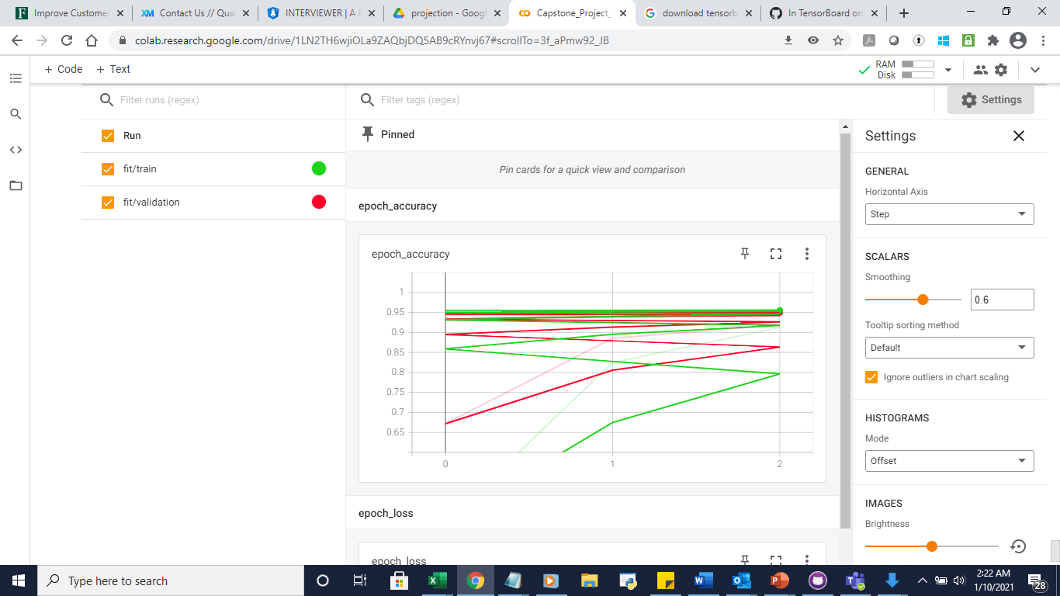
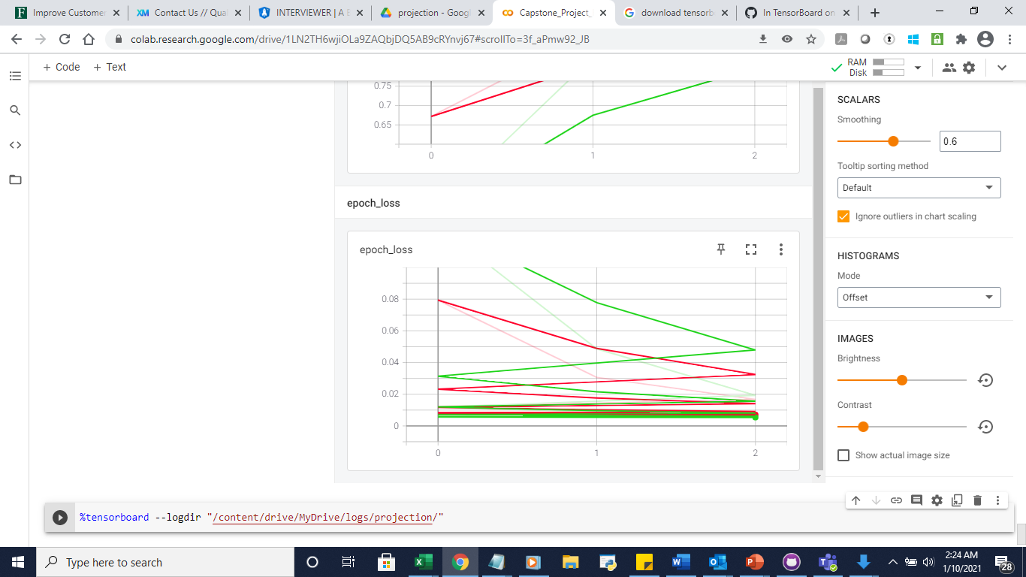

Slide 13
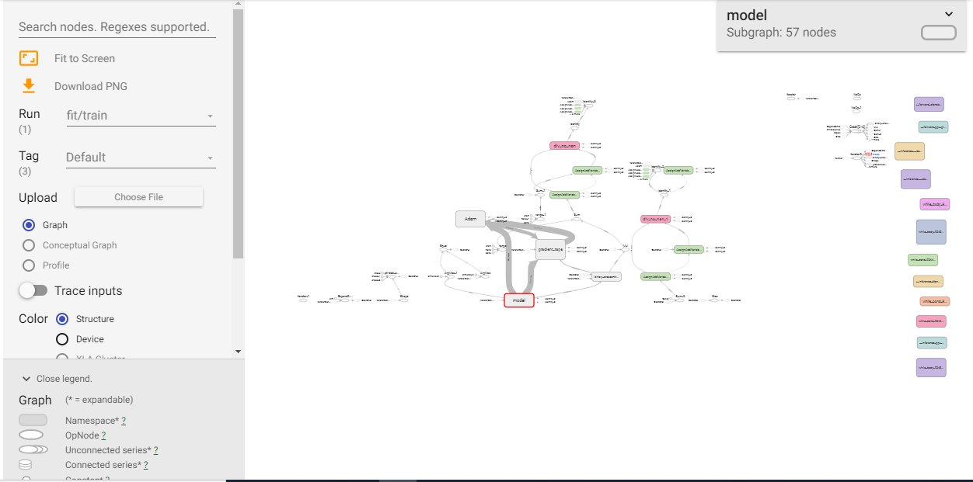

Slide 14
